Slide 1
ASP.NET MVC CORE
Instructor: Edwin oduor

Slide 2

Quote of the day

Slide 3
Lesson objectives
Dashboard

Slide 4
Lesson pre-requisites
In order to take full advantage of this section you need to have the following;
Computer with Visual Studio Installed.
Stable Network Connection.

Slide 5
Training methods and extra readings
TRAINING METHODS FOR THIS LESSON
EXTRA READINGS
Lecturing Method – This is the main method of training to be adopted in this lesson with illustrations and practical coding examples.
Discussion Method - This method will be adopted periodically whereby learning will be derived principally from the students brainstorming together, rather than from the trainer. Three main types of discussions will be used:
Directed discussion
Developmental discussion
Problem-Solving discussion
Home and Learn C#

Slide 6
Dashboard

Slide 7
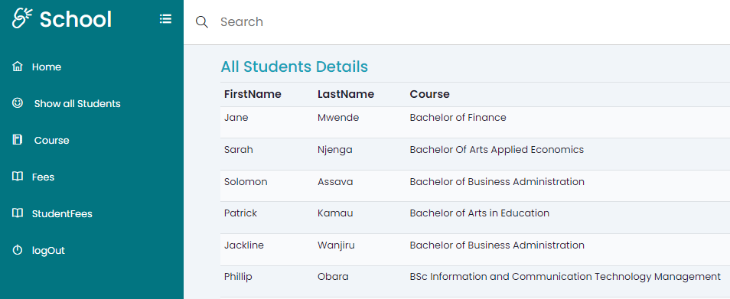
In this session will see how go about the dashboard, a dashboard is a central place where your system connects to other pages or modules in the system.

Slide 8
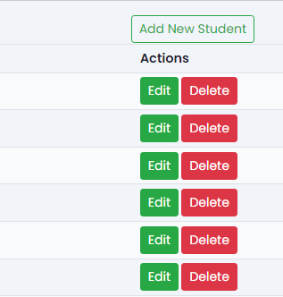
After each record we have buttons for Edit and Delete as shown below.

Slide 9
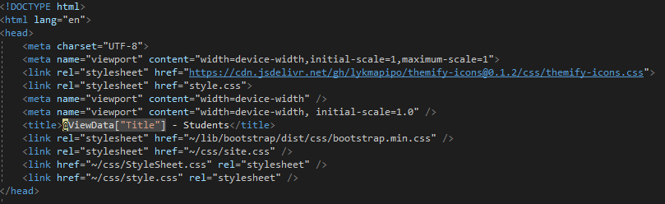
Code that is going to give us the output shown in the previous slide is this (_Layout).
In the head session will have the following.

Slide 10
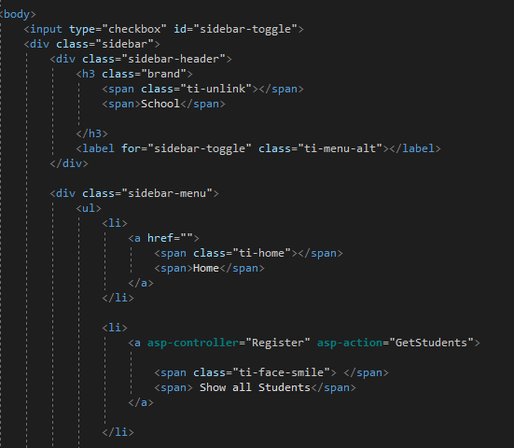
In the body session will have the following.

Slide 11
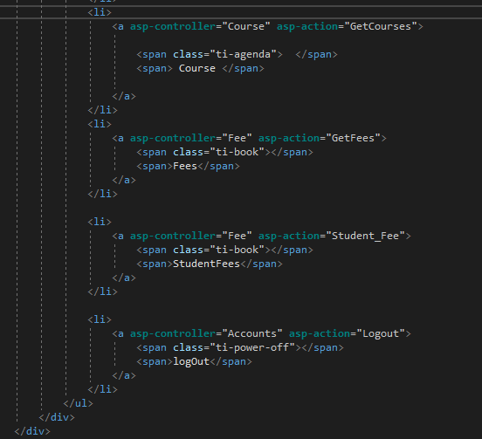
Continuation of the code.

Slide 12
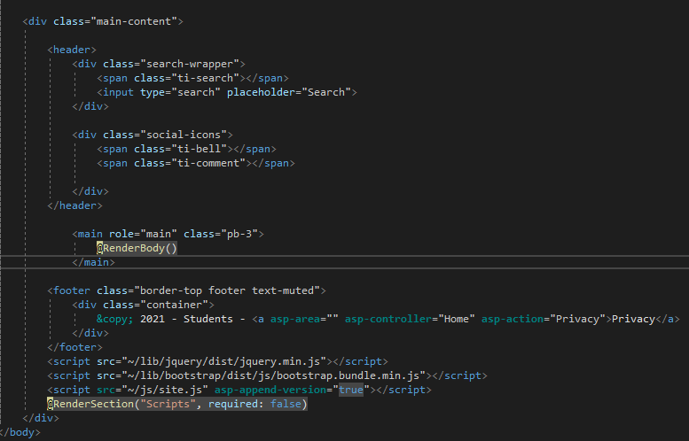
Continuation of the code.

